Slide 1
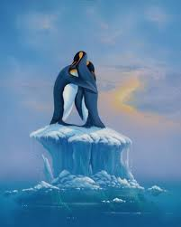
GLOBAL WARMING
Галич О.В.,
вчитель англійської мови,
Городищенський економічний ліцей

Slide 2
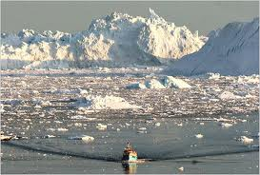
What is global warming?
Global warming is when the earth heats up (the temperature rises). It happens when greenhouse gases (carbon dioxide, water vapor, nitrous oxide, and methane) trap heat and light from the sun in the earth’s atmosphere, which increases the temperature. This hurts many people, animals, and plants. Many cannot take the change, so they die.

Slide 3
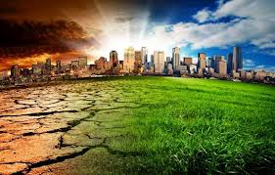
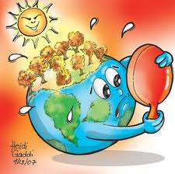
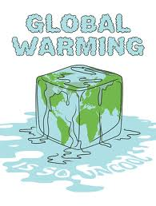
What is global warming doing to the environment?
Global warming is affecting many parts of the world. Global warming makes the sea rise, and when the sea rises, the water covers many low land islands. This is a big problem for many of the plants, animals, and people on islands.

Slide 4
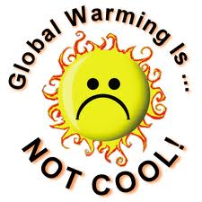
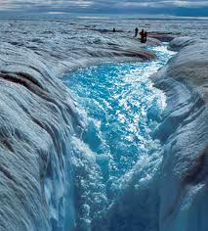
The water covers the plants and causes some of them to die. When they die, the animals lose a source of food, along with their habitat.

Slide 5
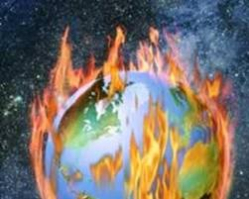
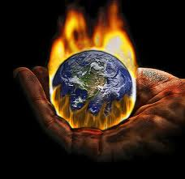
Although animals have a better ability to adapt to what happens than plants do, they may die also.
When the plants and animals die, people lose two sources of food, plant food and animal food. They may also lose their homes.

Slide 6
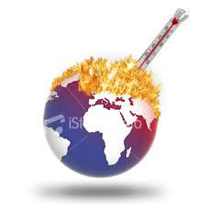
What causes global warming?
Many things cause global warming. One thing that causes global warming is electrical pollution. Electricity causes pollution in many ways, some worse than others. In most cases, fossil fuels are burned to create electricity. Fossil fuels are made of dead plants and animals. Some examples of fossil fuels are oil and petroleum.

Slide 7
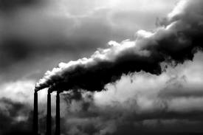
Many pollutants are sent into the air when fossil fuels are burned. Some of these chemicals are called greenhouse gasses.

Slide 8
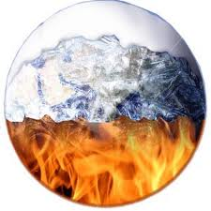
We use these sources of energy much more than the sources that give off less pollution. Petroleum, one of the sources of energy, is used a lot. It is used for transportation, making electricity, and making many other things.

Slide 9
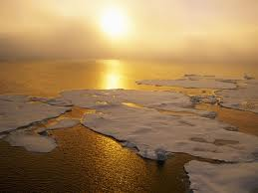
Result
As a result, they would also have to leave the area or die. This would be called a break in the food chain, or a chain reaction, one thing happening that leads to another and so on.
The oceans are affected by global warming in other ways, as well.

Slide 10
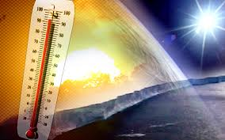
Many things that are happening to the ocean are linked to global warming. One thing that is happening is warm water, caused from global warming, is harming and killing algae in the ocean.

Slide 11
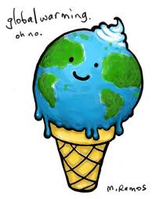
Solutions
Solving global warming will improve our lives by cleaning up air pollution while investing in clean energy, green jobs and smart energy solutions.

Slide 12
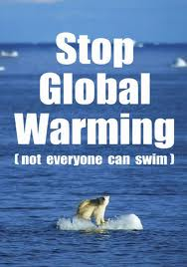
We need to drive smarter cars, save money with energy efficient homes and offices, and build better communities and transportation networks. See how we can solve the climate crisis today.

Slide 13
Бібліографія
http://en.wikipedia.org/wiki/Global_warming
http://topics.nytimes.com/top/news/science/topics/globalwarming/index.html

