Slide 1
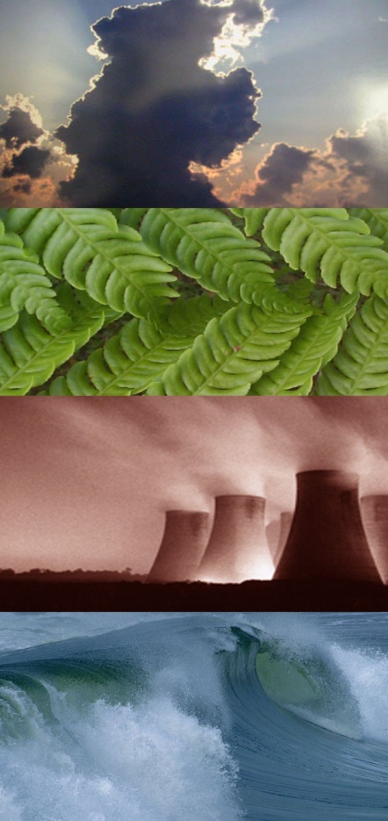
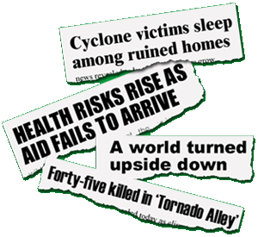
Global Climate Change
Галич О.В.,
вчитель англійської мови,
Городищенський економічний ліцей

Slide 2
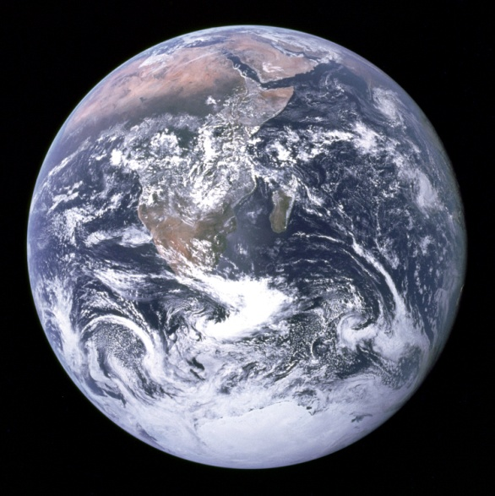
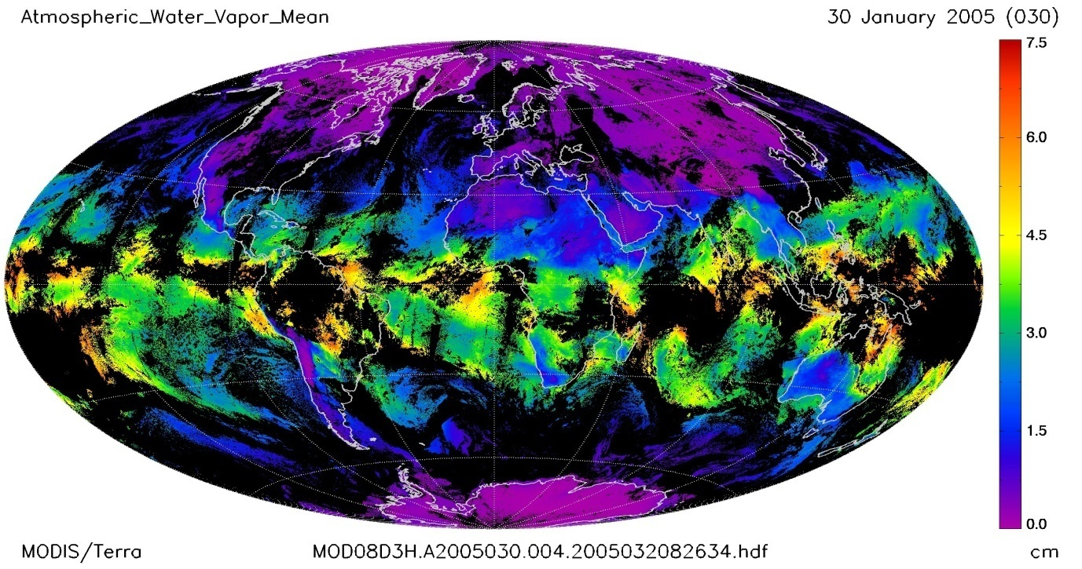
What is Climate?
Climate = the average and variations of weather over a long period of time (~30 years)
Above: Global average for atmospheric water vapor.
Notes:
Climate is defined as the weather averaged over a long period of time.
The standard averaging period is 30 years but other periods may be used depending on the purpose. Climate also includes statistics other than the average, such as the magnitudes of day-to-day or year-to-year variations.
Therefore, climate is “the average and variations of weather over long periods of time”.
Different “Climate Zones” such as tropical, temperate or polar can be defined using parameters such as temperature and rainfall.

Slide 3

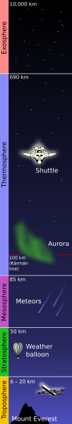
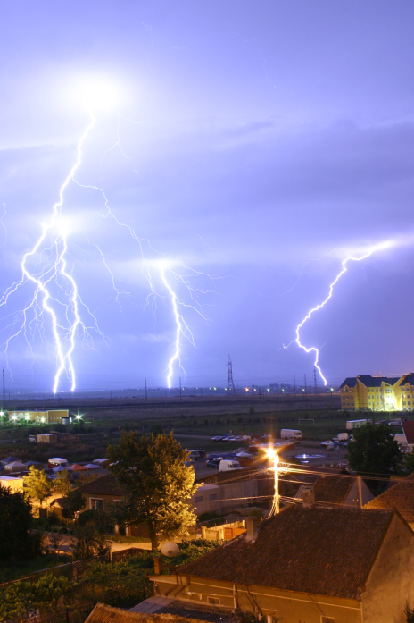
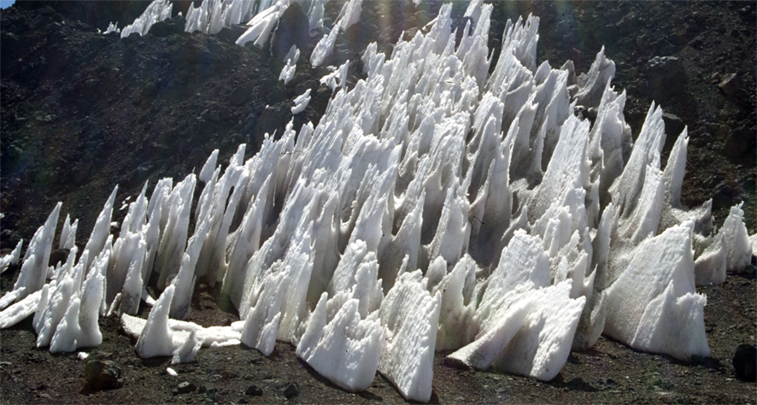
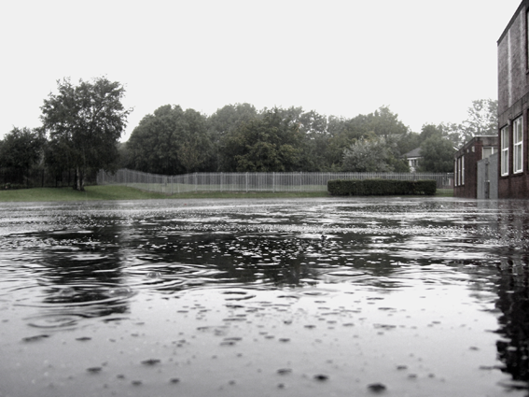
What is Weather?
Weather = all natural phenonmena within the atmosphere at a given time (hours to days)
Notes:
“.
The term usually refers to the activity of these phenomena over short periods (hours or days), as opposed to the term climate, which refers to the average atmospheric conditions over longer periods of time. When used without qualification, "weather" is understood to be the weather of Earth.
On Earth, common weather phenomena include such things as wind, cloud, rain, snow, fog and dust storms. Less common events include natural disasters such as cyclones and ice storms.
Almost all familiar weather phenomena occur in the troposphere (the lower part of the atmosphere - see figure on left). Weather does occur in the stratosphere and can affect weather lower down in the troposphere, but the exact mechanisms are poorly understood.

Slide 4
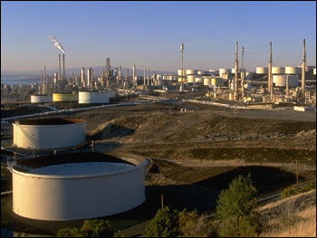
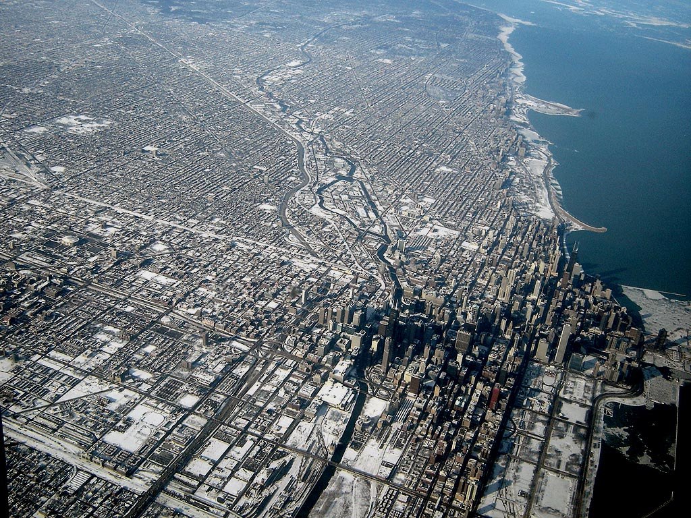
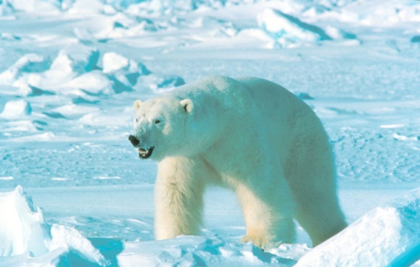
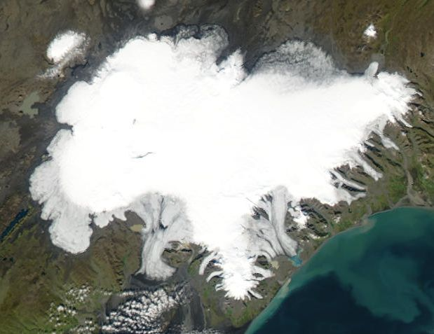
What is Climate Change?
Records change over decades to millions of years
Notes:
Climate change refers to the variation in the Earth's global climate or in regional climates over time.
It describes changes in the variability or average state of the atmosphere over time scales ranging from decades to millions of years.
These changes can be caused by processes internal to the Earth, external forces (e.g. variations in sunlight intensity) or, more recently, human activities.

Slide 5


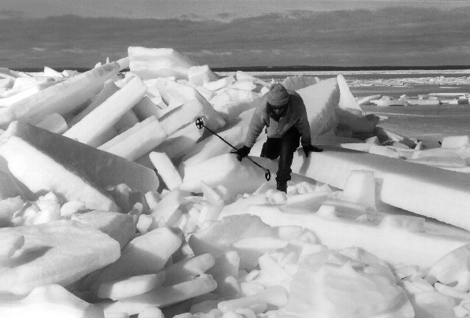

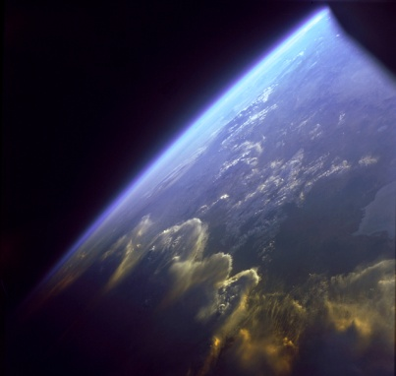

The Climate System
Oceans
Atmosphere
The Earth has many different systems that interact with each other in different ways.
Ice
Biosphere
Land
Notes:
The climate includes interaction between all areas on the surface of the Earth and in the atmosphere.
For example, water is evaporated from the ocean to form water vapor clouds in the atmosphere. The wind can then carry these clouds over the land where the water falls as rain or snow. Eventually the water may return to the ocean via rivers etc.
Also, the biosphere the living plants and animals, live in and utilize the land, sea and sky - so you can see how everything is connected.

Slide 6
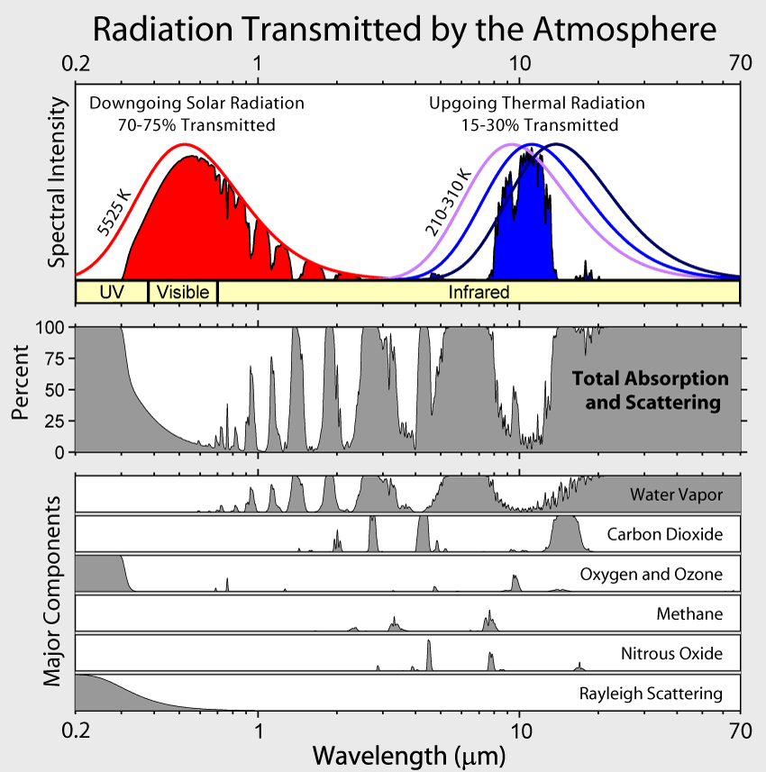
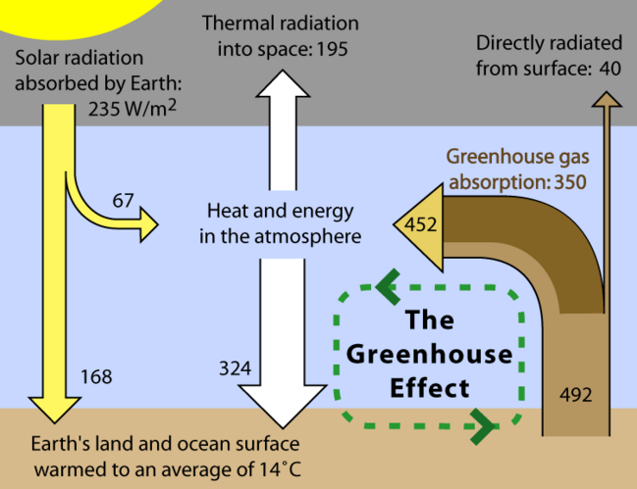
What is the Greenhouse Effect?
The temperature of the Earth depends on the amount of energy we receive from the sun versus the amount of energy lost back out to space.
Notes:
The Earth receives energy from the Sun in the form of radiation.
The Earth reflects about 30% of the incoming solar radiation. The remaining 70% is absorbed, warming the land, atmosphere and oceans.
For the Earth's temperature to be in equilibrium so that the Earth does not rapidly heat or cool, this absorbed solar radiation must be very nearly balanced by energy radiated back to space in the infrared wavelengths.
The figure on the left shows the absorption bands in the Earth's atmosphere (middle panel), I.e. the wavelength spectrum (UV, IR, visible light) that is absorbed by the atmosphere, and the effect that this has on both solar radiation (energy from the sun) and upgoing thermal radiation (energy reflected from the Earth) (top panel).
Individual absorption spectrum for major greenhouse gases are also shown.
You can see that high amounts of UV and IR wavelengths from the sun are absorbed by the atmosphere, whereas much of the visible light spectrum passes through (allowing us to see!). Of the up-going thermal radiation (blue) a budget of IR wavelengths pass through the atmosphere to be lost to space.
The figure on the right is a simplified, schematic representation of the flows of energy between space, the atmosphere, and the Earth's surface, showing how these flows combine to trap heat near the surface and create the greenhouse effect.
Energy exchanges are expressed in watts per square meter (W/m²); values from Kiehl and Trenberth (1997).
The sun provides an annual average of ~235 W/m² of energy to the Earth’s surface. If this were the total heat received at the surface, then we would be expect to have an average global temperature of -18°C. Instead, the Earth's atmosphere recycles heat coming from the surface and delivers an additional 324 W/m², which results in an average surface temperature of roughly +14 ° C.
Of the surface heat captured by the atmosphere, more than 75% can be attributed to the action of greenhouse gases (carbon dioxide, methane, nitrous oxide etc.) that absorb thermal radiation (the up-going energy emitted by the Earth's surface).
The atmosphere in turn transfers the energy it receives both into space (38%) and back to the Earth's surface (62%), where the amount transferred in each direction depends on the thermal and density structure of the atmosphere.
This process by which energy is recycled in the atmosphere to warm the Earth's surface is known as the greenhouse effect and is an essential piece of Earth's climate.
Under stable conditions, the total amount of energy entering the system from solar radiation will be exactly the same as the amount being radiated into space, thus allowing the Earth maintain a constant average temperature over time. However, recent measurements indicate that the Earth is presently absorbing 0.85 - 0.15 W/m² more than it emits into space (Hansen et al. 2005). This increase, associated with global warming, is believed to have been caused by the recent increase in greenhouse gas concentrations.
References:
Kiehl, J. T. and Trenberth, K. E. (1997). "Earth's Annual Global Mean Energy Budget". Bulletin of the American Meteorological Association 78: 197-208.
Hansen, J., et al. (2005). "Earth's Energy Imbalance: Confirmation and Implications". Science 308 (5727): 1431-1435.

Slide 7
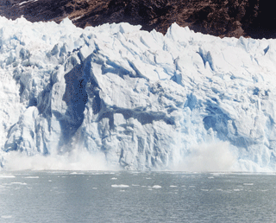
Is the Climate Changing?
Notes:
In the following section we will discuss the past and current trends in climate change and use these models to look towards the future.

Slide 8
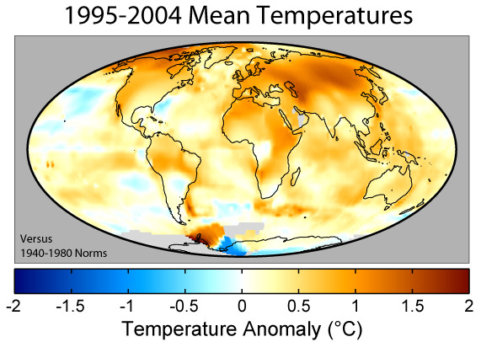
What are the current climate trends?
Notes:
If you put the data on the last slide onto a map to plot where the temperature changes are occurring, you get the above figure.
Note: Some parts of Antarctica have become colder. Whereas the majority of the northern hemisphere is warmer. On average the UK has become 1°C hotter

Slide 9
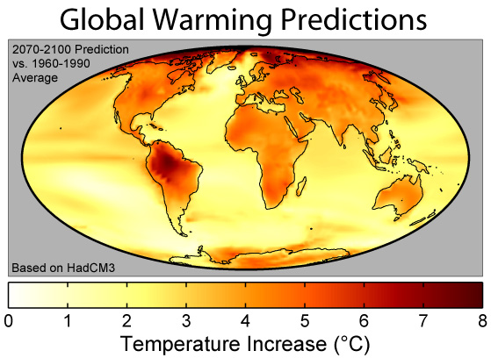
Future predictions…
Based on no changes in emissions (“business as usual”)
The UK would be 2-3.5°C hotter on average.
Notes:
This figure shows the predicted distribution of temperature change due to global warming from the Hadley Centre HadCM3 climate model.
These changes are based on the IS92a ("business as usual") projections of carbon dioxide and other greenhouse gas emissions during the next century, and essentially assume normal levels of economic growth and no significant steps are taken to combat global greenhouse gas emissions.
The plotted colors show predicted surface temperature changes expressed as the average prediction for 2070-2100 relative to the model's baseline temperatures in 1960-1990.
The average change is 3.0°C, placing this model on the lower half of the Intergovernmental Panel on Climate Change's 1.4-5.8°C predicted climate change from 1990 to 2100.
As can be expected from their lower specific heat, continents are expected to warm more rapidly than oceans with an average of 4.2°C and 2.5°C in this model respectively. The lowest predicted warming is 0.55°C south of South America and the highest is 9.2°C in the Arctic Ocean (points exceeding 8°C are plotted as black).
Note the large increase in temperature over the South American continent. A result of the loss of the Brazilian rainforest.

Slide 10
What is the worst thing that could happen?
More Drought

Slide 11
More Forest Fires

Slide 12
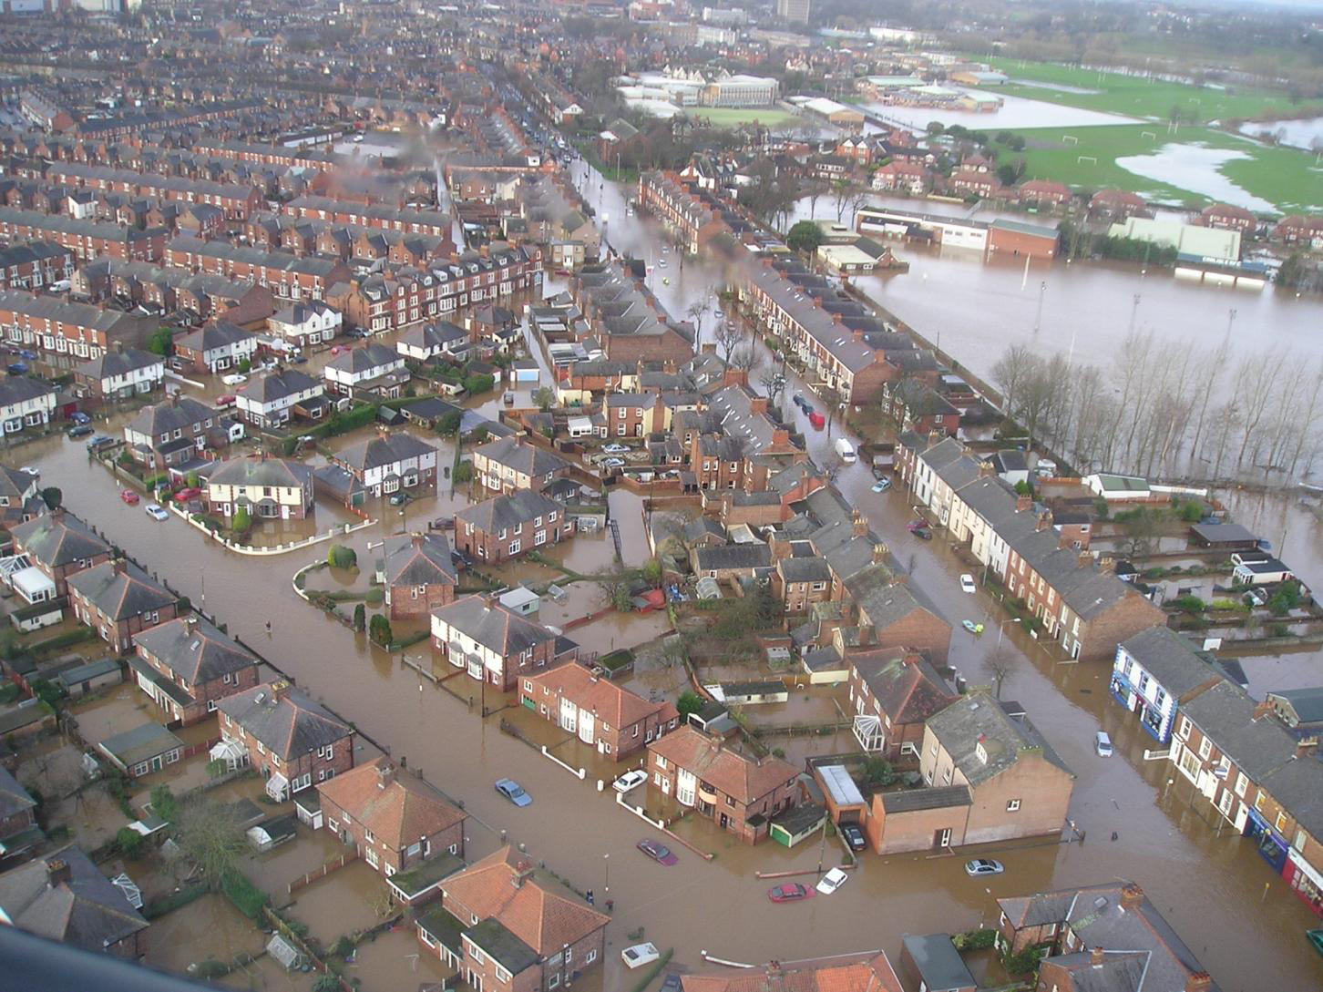
More Rainfall

Slide 13
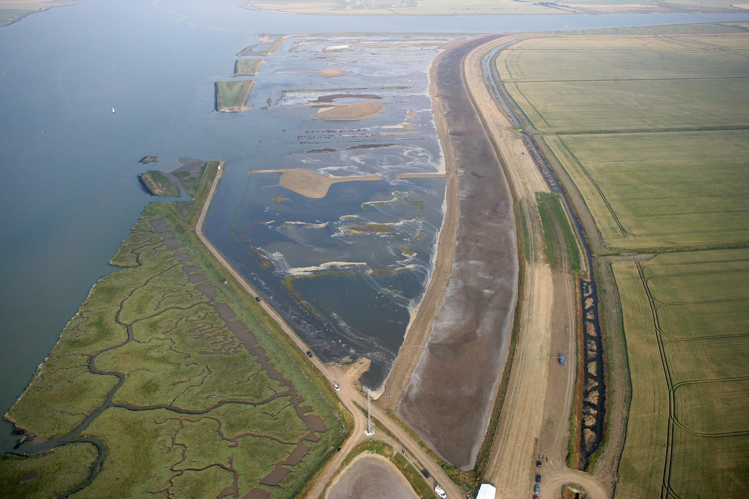
Rising Sea Level

Slide 14
More Hurricanes

Slide 15
The ways to solve the problem
Recycle
Turn off lights
Low energy light bulbs
Shorter showers
Recycle «grey»water
Install solar panels
Walk or ride instead of taking a vehicle

Slide 16
Бібліографія
http://www.paleo.bris.ac.uk/~ri5774/publications.html
http://www.globalwarmingart.com/wiki/Image:Global_Warming_Predictions_Map_jpg
http://www.globalwarmingart.com/wiki/Image:Global_Warming_Map_jpg

