Slide 1
Describing Pain and Symptoms
Денисюк Валентина Іванівна,
Коваленко Олена Сергіївна, -----англійської мови Руськополянської загальноосвітньої школи І-ІІІ ступенів №1

Slide 2
By the end of our lesson you will be able:
- to list parts of a body, common health problems and symptoms;
- to use different words to describe pain;
- to describe your symptoms to a doctor.

Slide 3
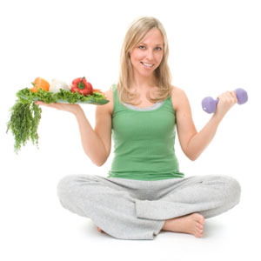
Healthy body

Slide 4
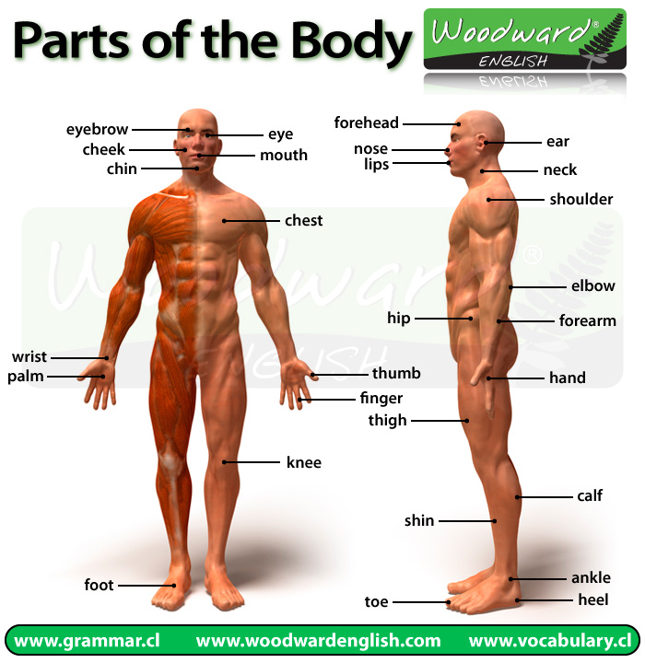
Parts of the body

Slide 5
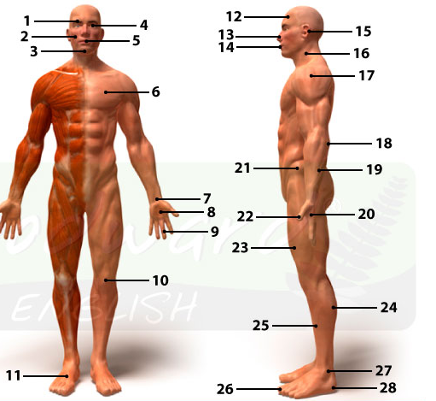
Name all the parts of the body you remember

Slide 6
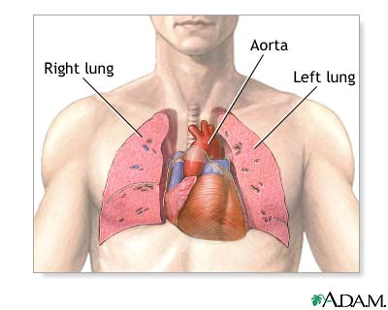
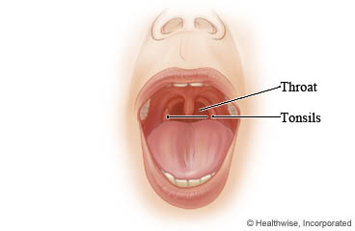
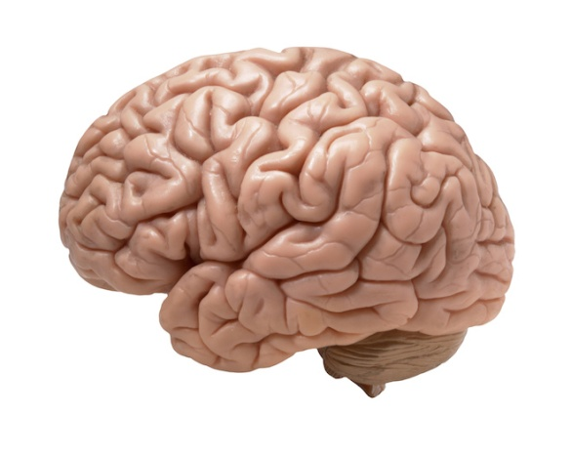
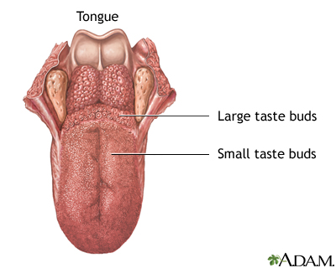
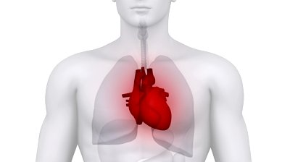
Get to know some organs of your body
Brain
Heart

Slide 7
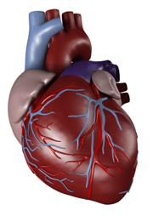
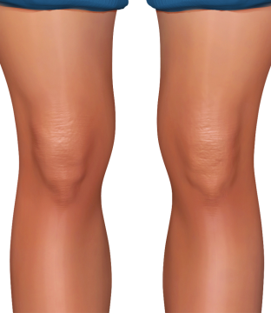
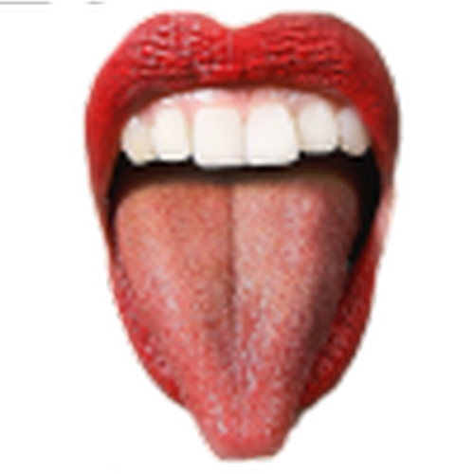
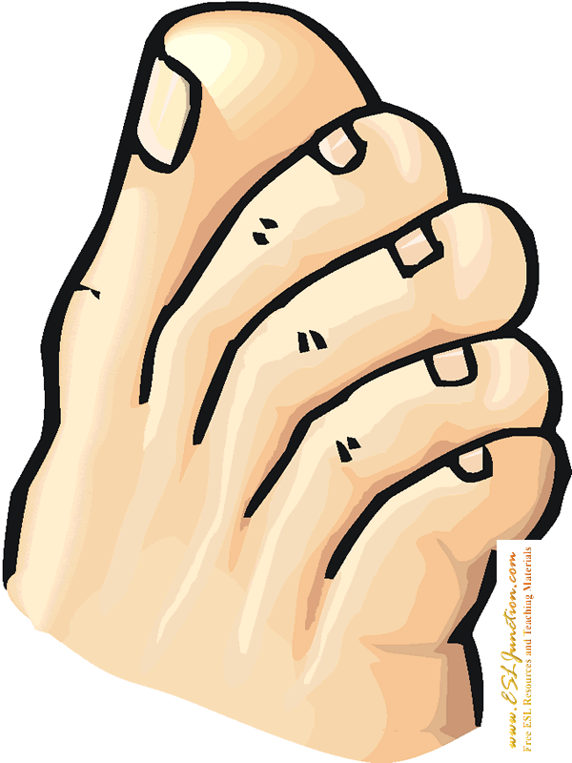
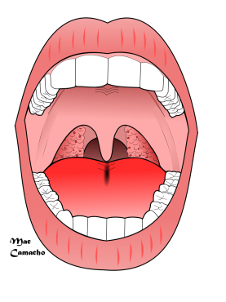
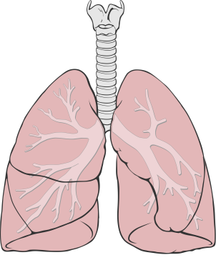
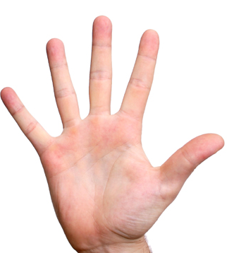
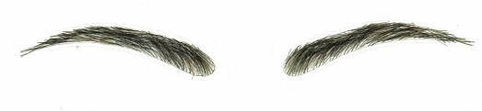
Do you know your body?
What are organs? And what are parts of your body?

Slide 8
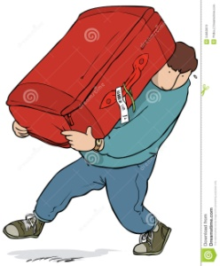
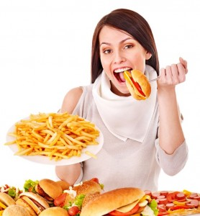
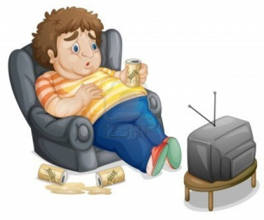
Which of the parts can people damage by …
a) smoking
b) carrying heavy objects
c) drinking too much alcohol
d) eating too much fatty food
e) watching TV all day long?

Slide 9
Choose the words in the box and complete idiomatic phrases
Skin neck heart face chest tooth bones
Ironing is my least favourite activity. It’s a real pain in the _______.
The pass mark was 60% and he got 60.3%, so he made it by the _______ of his teeth.
3. I know I should got to the meeting by I just can’t _____ it.
4. She has always kept her feelings for herself. She is not a sort of person to wear her ______ on her sleeve.
5. I cannot resist chocolate and cakes - I have a sweet _____ .
6. The first thing to start solving a problem is to get it off your ____
7. I think there is going to be trouble at the meeting tonight; I can feel it in my _____

Slide 10
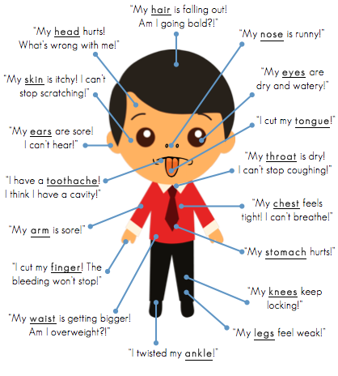
“Doctor! I need your help!”

Slide 11
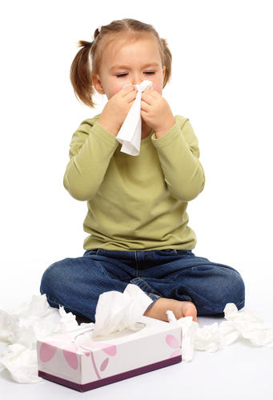
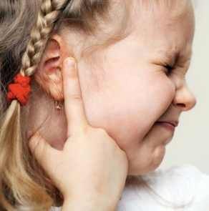
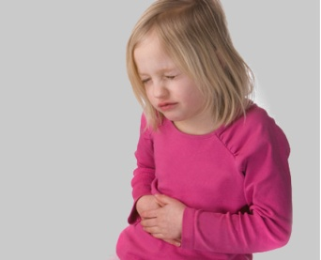
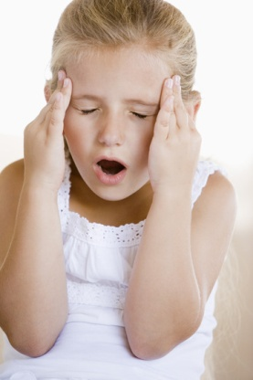
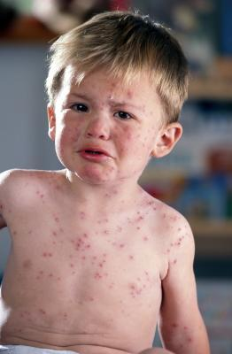
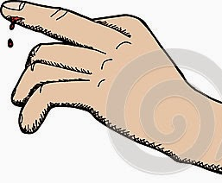
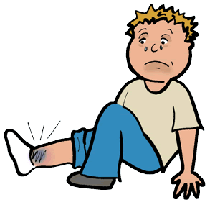
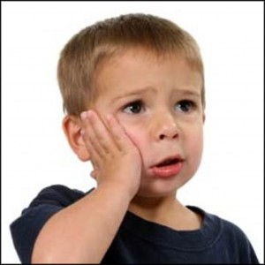
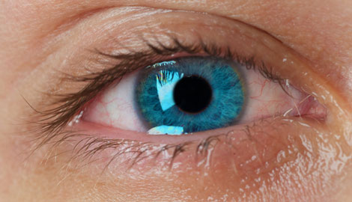
What is wrong with the children? Match each picture with the problem.
My head hearts.
My nose is runny.
My stomach hurts.
My skin is itchy.
My ears are sore.
I have a toothache.
I twisted my ankle.
I cut my finger.
My eyes are dry and watery.

Slide 12
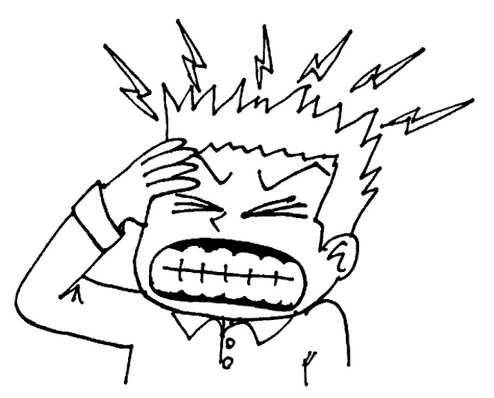
Look at the picture and answer the questions.
How does the man feel?
How often do you feel this way?

Slide 13
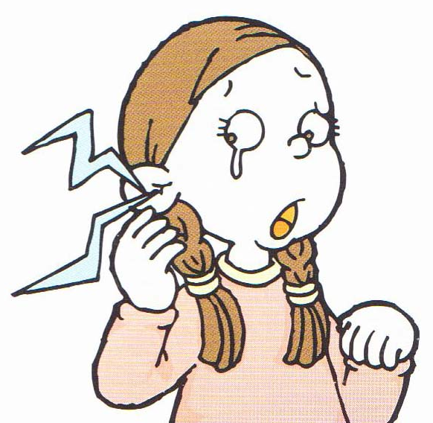
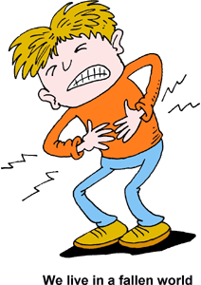
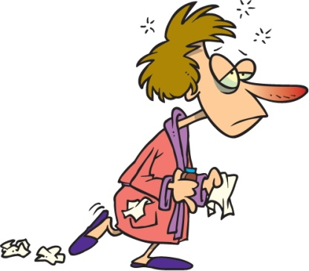
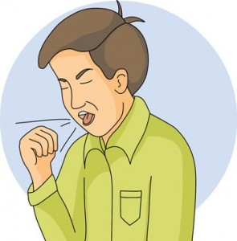
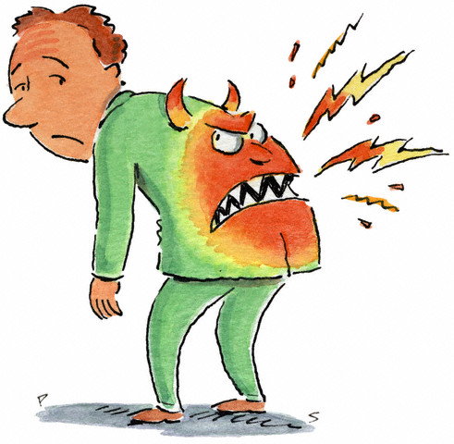
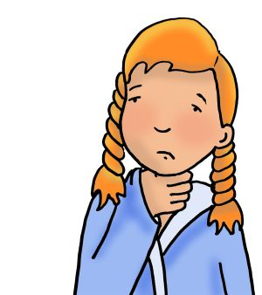
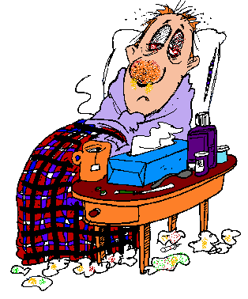
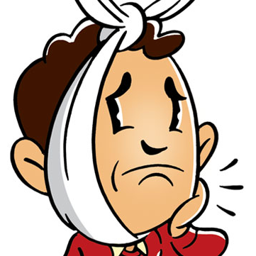
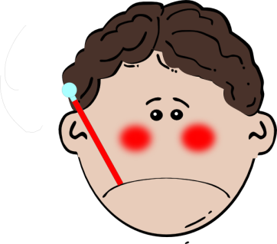
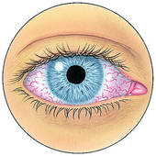
Vocabulary
A cough
a backache
an earache
a stomachache
the flu
a toothache
a fever
sore eyes
a sore throat
a bad cold

Slide 14
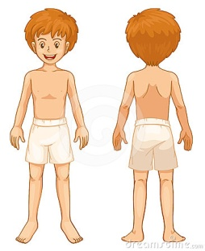
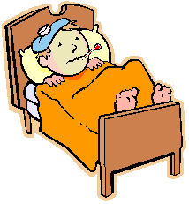
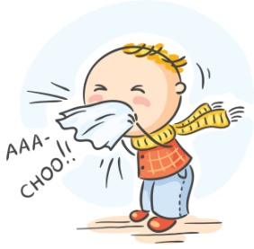
Group up the words from the box into 3 columns
Lung, headache, to sneeze, a sore throat, heart, to cough, aorta, throat, toothache, tongue, a bad cold, high temperature, flu, knee
A part of the body | An illness | A symptom

Slide 15
Match the symptoms
_____1. flu a. sore chest
_____ 2.rash b. can’t swallow
_____ 3. cold c. can’t walk
_____ 4. cough d. purple skin
_____ 5. sore throat e. can’t bend
_____ 6. cut finger f. red, itchy skin
_____ 7. sprained ankle g. sneezing
_____ 8. big bruise h. bleeding
_____ 9. back-ache i. fever and chills

Slide 16
Fill in the blanks with the correct form of the verb to have:
1. I __________ a bad cold.
2. He __________ a sore throat.
3. My sister __________ the flu.
4. Do you __________ a headache?
My father __________ a toothache.
Does your granny ___________ a backache?

Slide 17
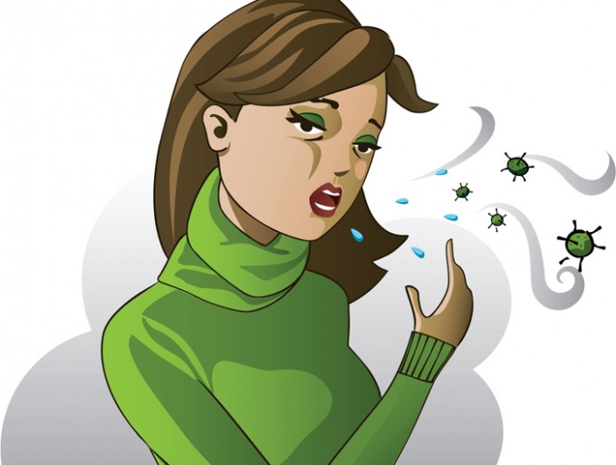
Describing symptoms
Now you are going to read a story about Jane. Read the story and then answer the questions.
Today I feel very sick. I think I have a cold. I have a headache and
a sore throat. I have an earache and I’m coughing. I feel terrible.
I can’t go to work. I have an appointment with the doctor today at
2:00. I hope I feel better tomorrow.
1. How does Nina feel today?
2. What are her symptoms?
3. What is she going to do?

Slide 18
Grammar Tip: have + noun; feel +adjective
What’s the matter? What’s wrong? | How do you feel? | Adjectives
I have a headache. You have sore throat. She has the flu. We have a cold. You have a stomachache. They have a backache. | I feel sick. You feel sad. She feels bad. We feel awful. You feel terrible. They don’t feel well. | sick/fine (well) sad/happy bad/good (better) awful/great terrible/terrific

Slide 19
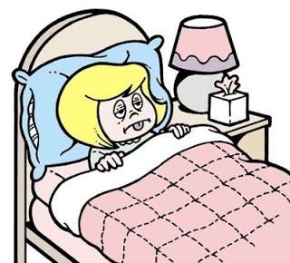
Fill in the blanks with the correct form of the verbs have or feel. When you are finished, practice this conversation with a partner.
A: Hi Svitlana. How are you?
B: I __________ terrible.
A: What’s the matter?
B: I __________ a headache and a sore throat.
A: That’s too bad. Do you __________a cold?
B: Yes. I__________ an appointment to see the doctor today.
A: Well, I hope you __________ better.
B: Thanks.

Slide 20
Writing Practice
Now write about how you feel today.
______________________________________________
______________________________________________
______________________________________________
____________________________________________

Slide 21
REFERENCES
http://www.myenglishteacher.eu/
http://escurriculum.spps.org/
https://sisu.ut.ee

