Slide 1
Great Travellers
Автор:
Починок Ірина Миколаївна
методист РМК
при відділі освіти
Маньківської РДА

Slide 2
Subject
Great
Travellers

Slide 3
Aims and Objectives:
To develop listening and speaking skills
To develop socio-cultural competence

Slide 4
-to learn more about other countries
-to meet new people - to see the world
-to practise foreign languages - to visit some friends
-on business -for pleasure
Why do people
travel?
-to go to warm seas -to have a rest
-to get a job -to leave home -to have a break
-to do something different -to visit famous places
-to study abroad

Slide 5
How can people travel ?
By land
car
on foot
By air
plane
helicopter
By water
boat
liner
train
bus
hot air balloon
ship
ferry

Slide 6
A POEM
Now mix me a colour that nobody knows,
And paint me a country where nobody goes.
And put in it people a little like you,
Watching a strange country is always new.

Slide 7
Match:
1.China a) Europe
2.Brazil b) Africa
3.France c) Australia
4.Canada d) South America
5.Egypt e) North America
6.Australia f) Asia
Keys: 1-f, 2-d, 3-a, 4-e, 5-b, 6-c

Slide 8
James Cook

Slide 9
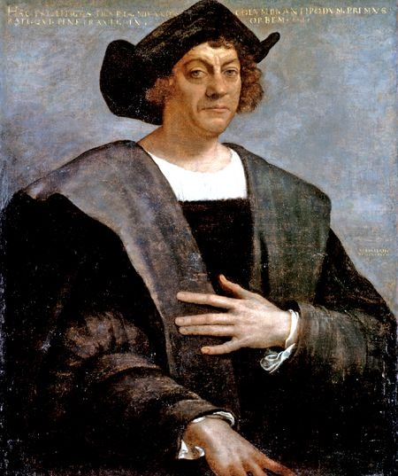
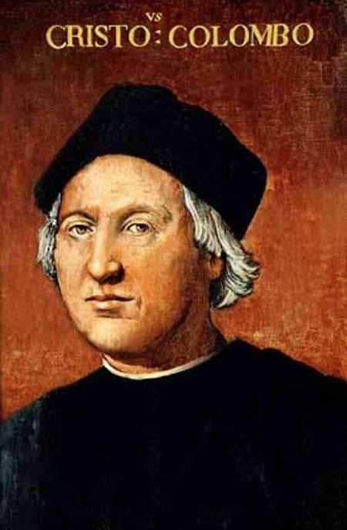
Christopher Columbus

Slide 10
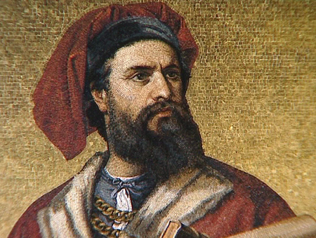
Marco Polo

Slide 11
Amerigo Vespucci

Slide 12
Ferdinand Magellan

Slide 13
Match:
1.Christopher Columbus a) Australia
2.James Cook b) South America
3.Ferdinand Magellan c) North America
1 – c
2 – a
3 - b

Slide 14
Make up a dialogue
Do you like to travel?
What countries did you go to ?
You have visited a lot of cities and towns, haven’t you?
What interesting places did you see there?
What country would you like to travel to ?
What do you know about this country?

Slide 15
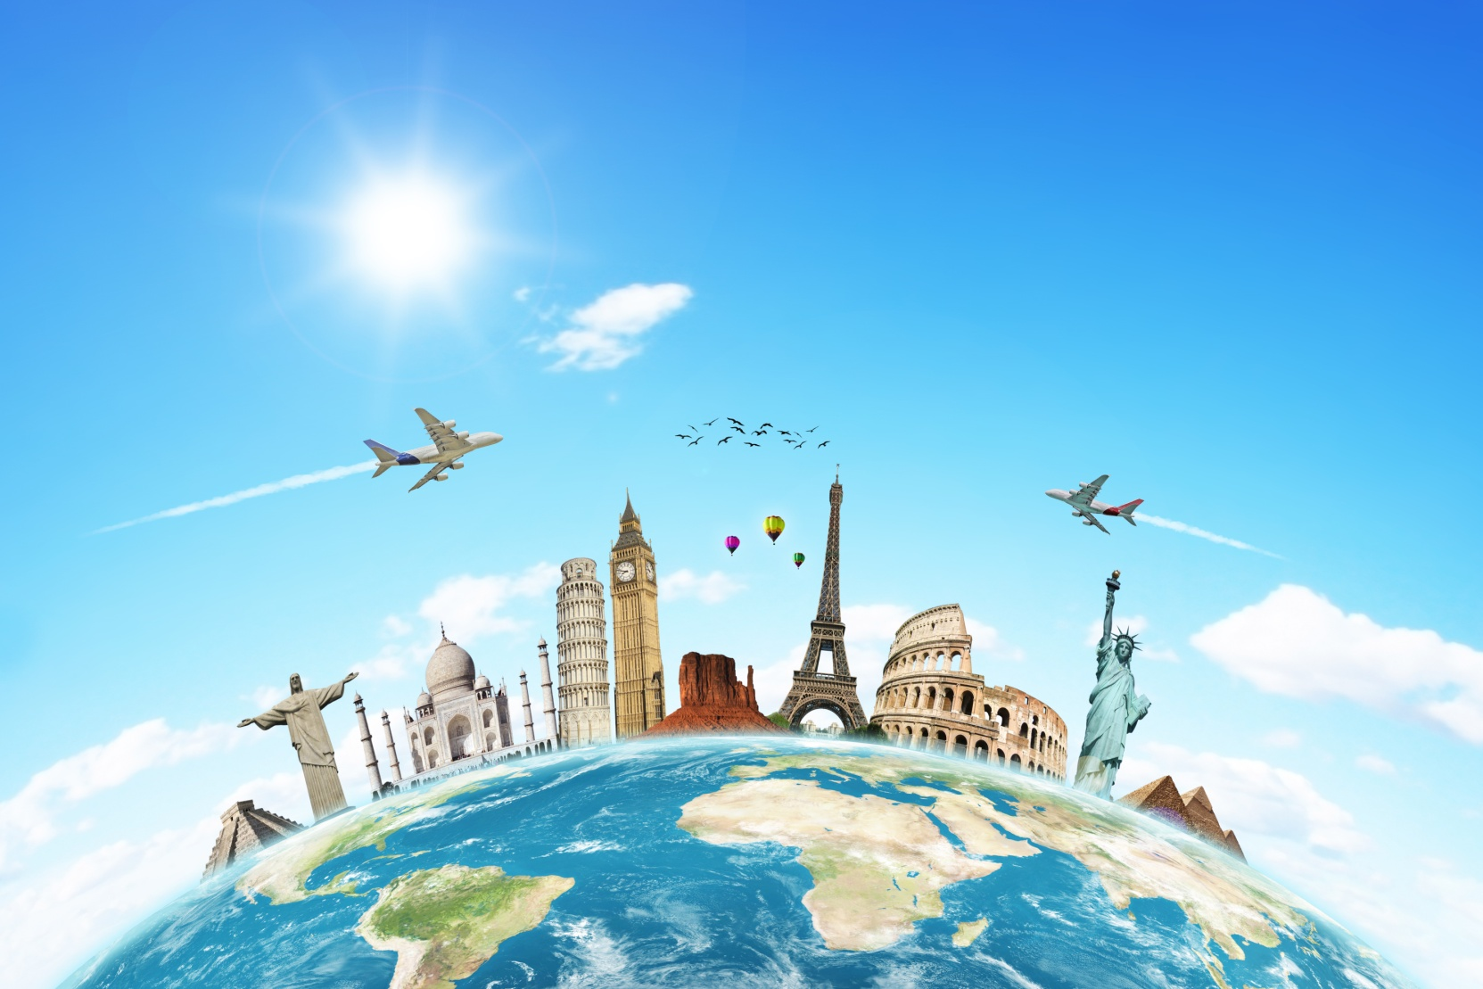
So many countries,
So many customs

Slide 16
SOURCES
Karpiuk O. English 6, Pupil’s Book. Ternopil, 2014
2. www.giffile.ru

