Slide 1
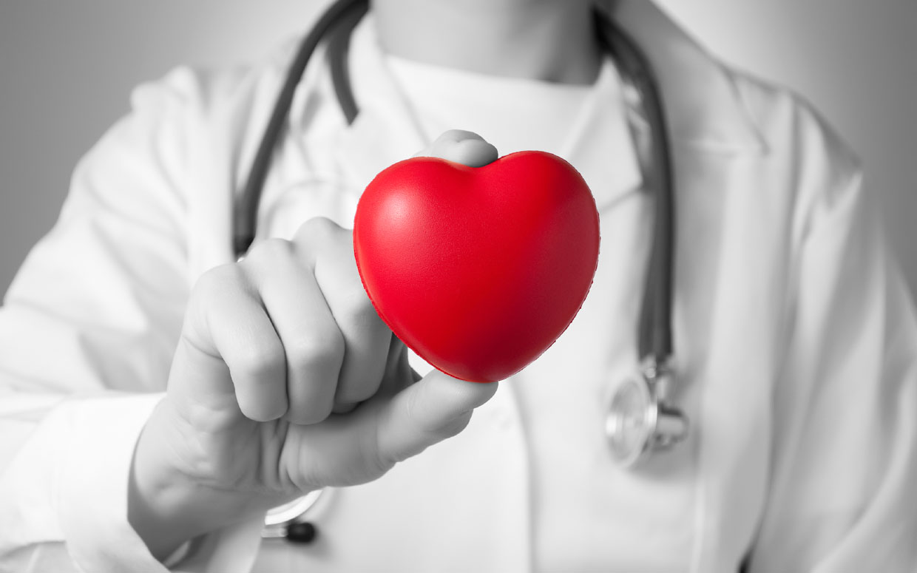
Health care vocabulary
Денисюк В.І., Коваленко О.С.
вчителі англійської мови
Руськополянської загальноосвітньої
школи І-ІІІ ступенів №1

Slide 2
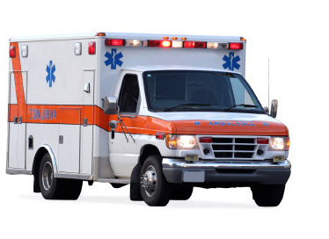
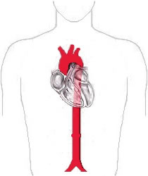
Ambulance is a vehicle used for taking hurt or sick people to the hospital especially in emergencies.
Allergy is a medical condition that causes someone to become sick after eating, touching, or breathing something that is harmless to most people.
Aorta is the large artery that brings blood from the heart to the rest of the body.

Slide 3
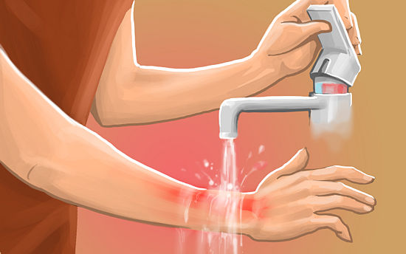
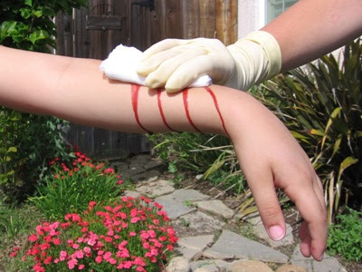
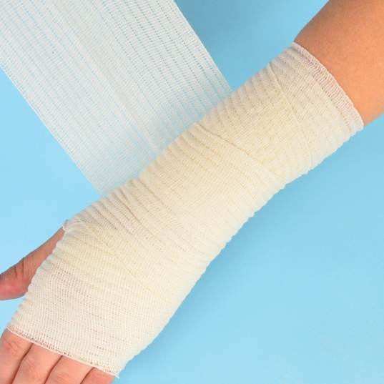
Burn is an injury caused by fire, heat, acid, etc.
Bandage is a covering (such as a strip of cloth) that protects or supports part of the body that has been hurt.
Bleeding is the process of losing blood.

Slide 4
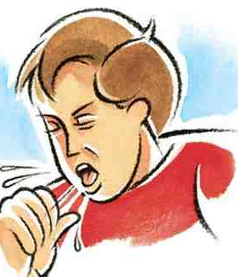
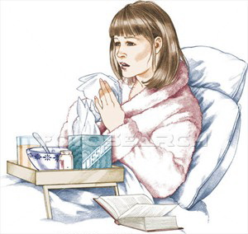
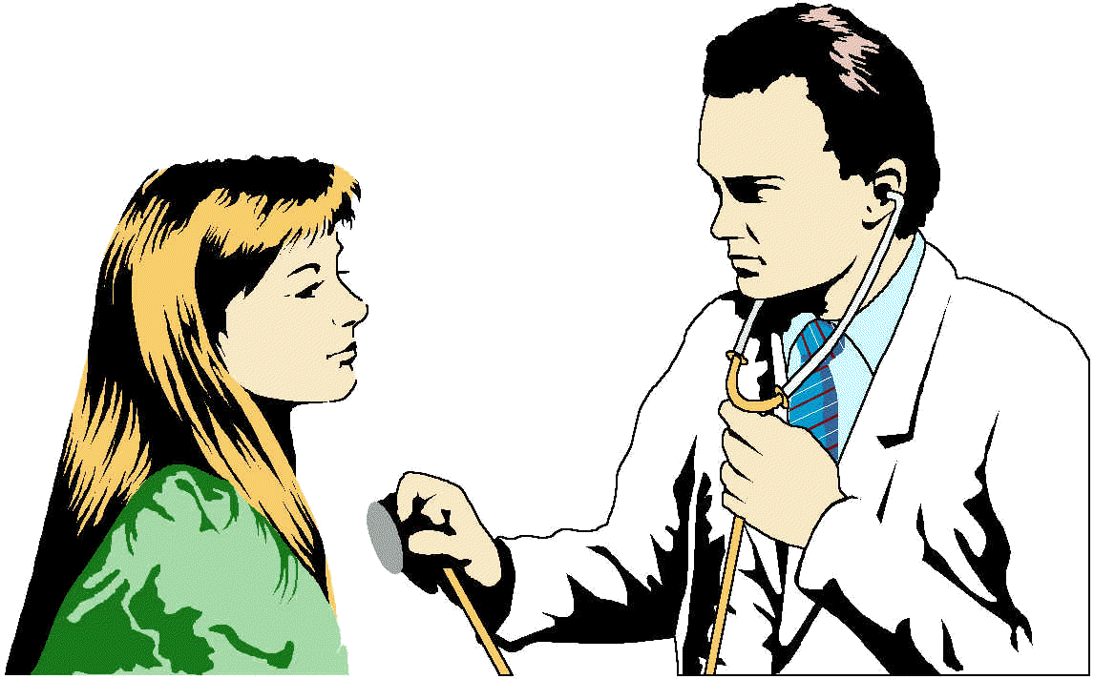
Cough (v) means to force air through your throat with a short, loud noise often because you are sick.
Cold is a common illness that affects the nose, throat, and eyes and that usually causes coughing, sneezing, etc.
Checkup is an examination of a person made by a doctor to make sure the person is healthy.

Slide 5
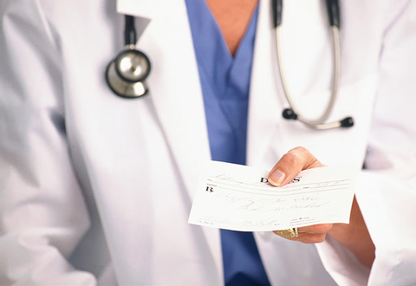
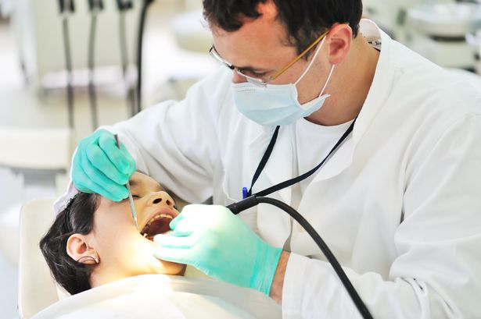
Dosage is the amount of a medicine, drug, or vitamin that should be taken at one time or regularly during a period of time — usually singular.
Diagnosis is the act of identifying a disease, illness, or problem by examining someone or something.
Dentist is a person whose job is to care for people's teeth.

Slide 6
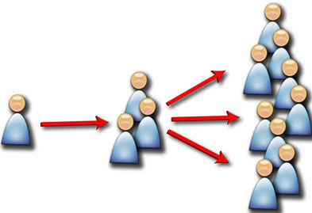
Earache is an ache or pain in the ear.
Exercise is physical activity that is done in order to become stronger and healthier.
Epidemic is an occurrence in which a disease spreads very quickly and affects a large number of people.

Slide 7
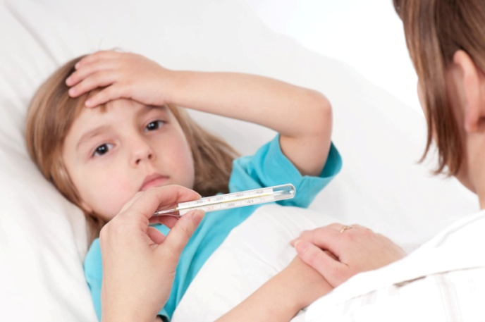
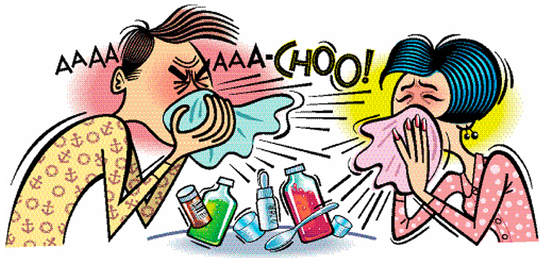
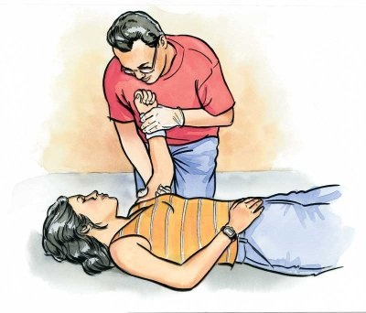
Fever is a body temperature that is higher than normal.
Flu is a common disease that is caused by a virus and that causes fever, weakness, body aches, and breathing problems.
First aid is emergency treatment given to a sick or injured person.

Slide 8
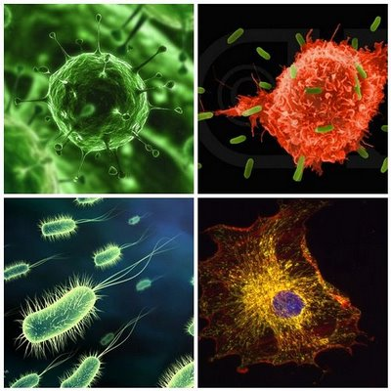
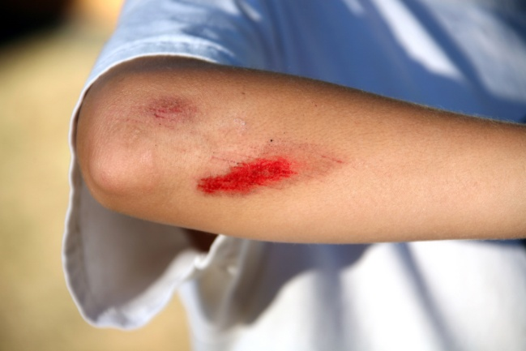
Gargle means to clean your throat and mouth with a liquid that you move around in your throat and then spit out.
Germ is a very small living thing that causes disease.
Graze is an injury on your skin that is caused because it moves against something.

Slide 9
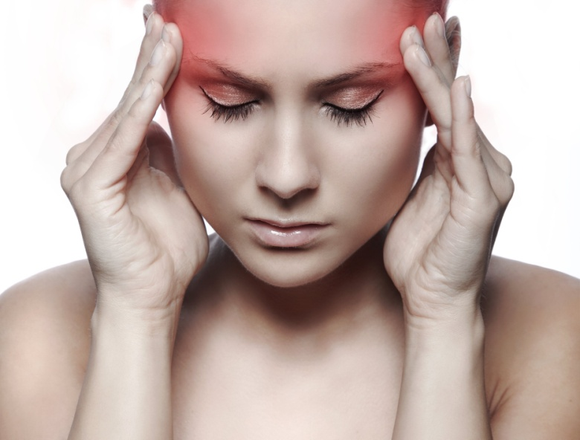
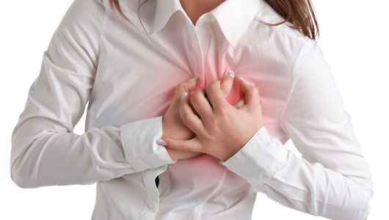
Hale and hearty - in very good health
Headache is an ache or pain in the head.
Heart attack is a sudden painful and dangerous condition in which your heart stops beating properly.

Slide 10
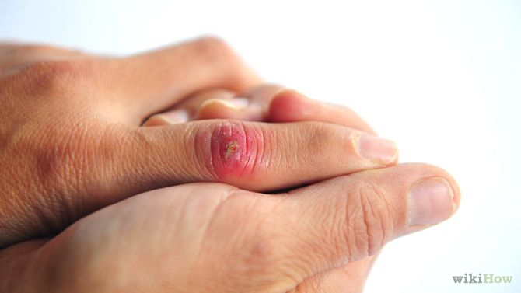
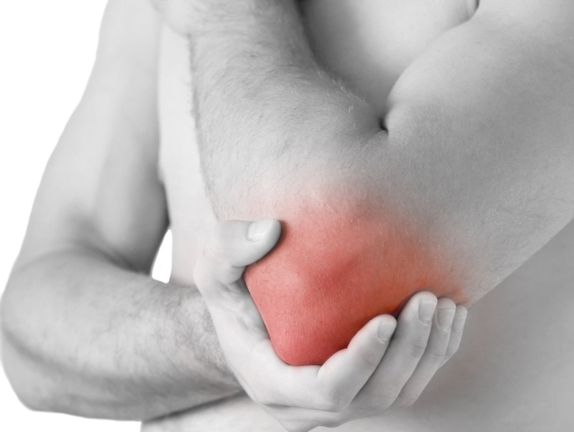
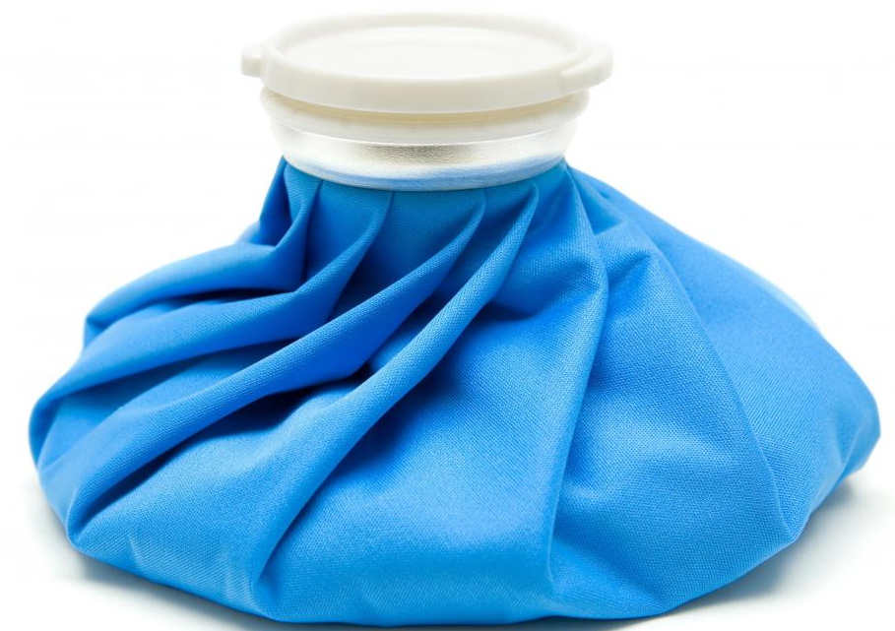
Infection is a disease caused by germs that enter the body.
Injury is harm or damage; an act or event that causes someone or something to no longer be fully healthy or in good condition.
Ice pack is a container or bag filled with ice that is used to cool part of your body.

Slide 11
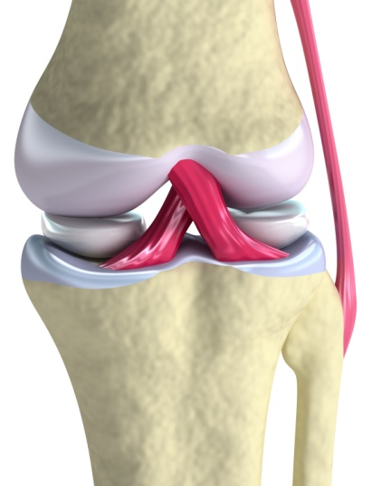
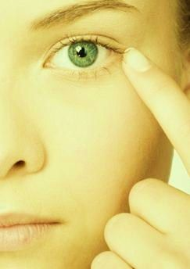
Joint is a point where two bones meet in the body.
Jaundice is a disease that causes a person's skin to turn yellow.
The jitters - a very nervous feeling

Slide 12
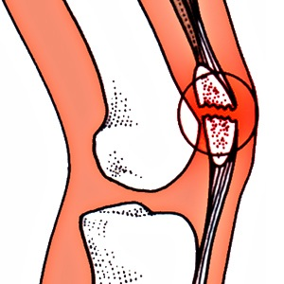
Knuckle is any one of the thick, bony parts (called joints) in your fingers.
Kneecap is a flat bone on the front of your knee.

Slide 13
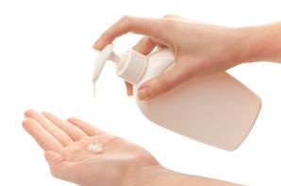
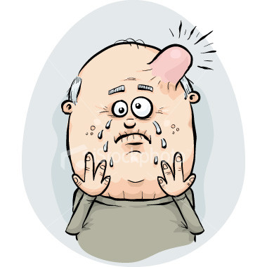
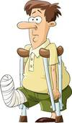
Lotion is a liquid that is rubbed onto your skin or hair.
Lump is an area of swelling or growth on your body.
Lame (adj) - having an injured leg or foot that makes walking difficult or painful

Slide 14
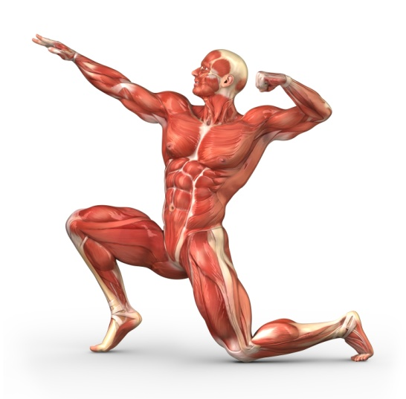
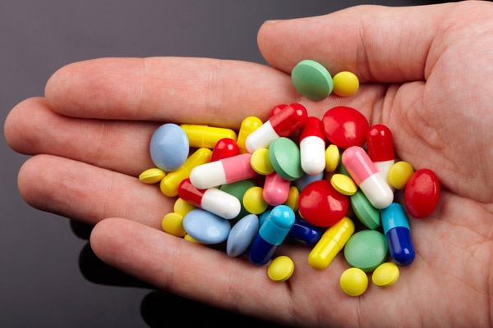
Muscle is a body tissue that can contract and produce movement.
Medicine is a substance that is used in treating disease or relieving pain and that is usually in the form of a pill or a liquid.
Massage is the action of rubbing or pressing someone's body in a way that helps muscles to relax or reduces pain in muscles and joints.

Slide 15
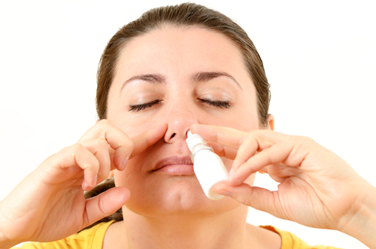
Nurse is a person who is trained to care for sick or injured people and who usually works in a hospital or doctor's office.
Nasal spray is a type of liquid medicine that is atomized into a fine spray and inhaled through the nose.
Nosebleed is a condition in which you are bleeding from your nose.

Slide 16
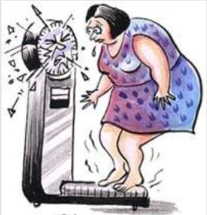
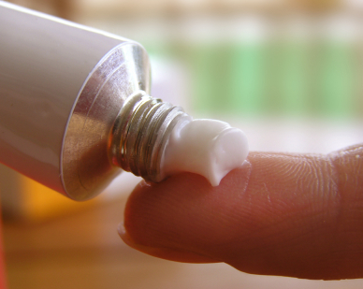
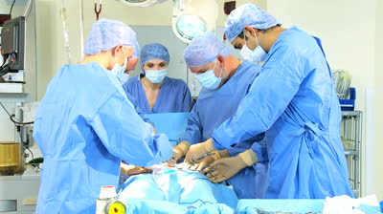
Obesity means very fat; fat in a way that is unhealthy
Ointment is a smooth substance that is rubbed on the skin to help heal a wound or to reduce pain or discomfort.
Operation is a process in which a doctor cuts into someone's body in order to repair or remove a damaged or diseased part.

Slide 17
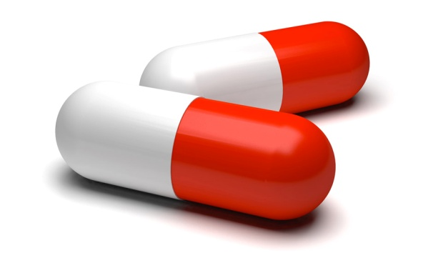
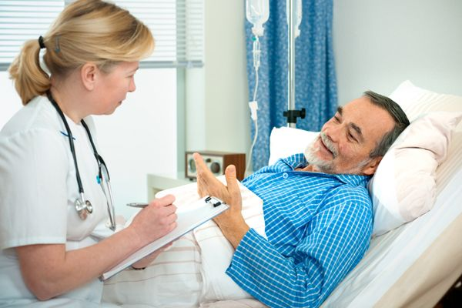
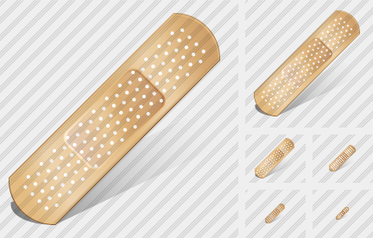
Pill is a small, rounded object that you swallow and that contains medicine, vitamins, etc.
Plaster is a piece of material that is put on the skin over a small wound.
Patient is a person who receives medical care or treatment.

Slide 18
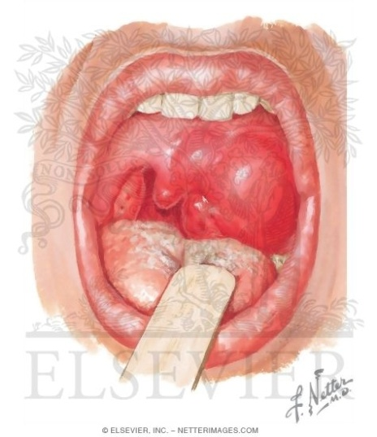
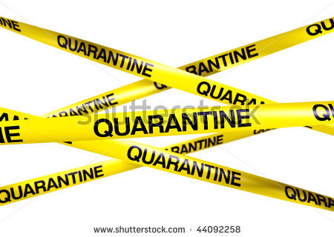
Quinsy is an abscess in the tissue around a tonsil usually resulting from bacterial infection and often accompanied by pain and fever.
Quarantine is a period of time in which a sick person is kept away from others to prevent the spread of disease.

Slide 19
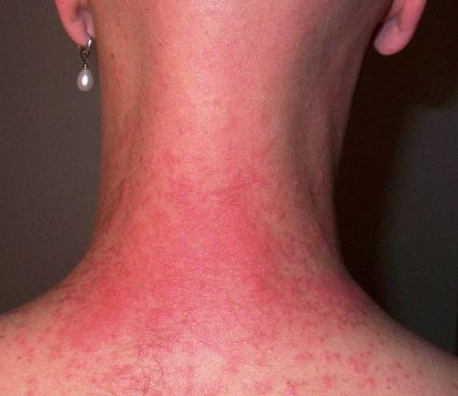
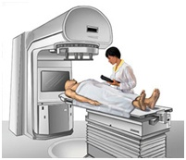
Rash is a group of red spots on the skin that is caused by an illness or a reaction to something.
Recovery is the act or process of becoming healthy after an illness or injury.
Radiation therapy is a treatment with high-energy rays (from x-rays or other sources) designed to control disease and destroy cancer cells.

Slide 20
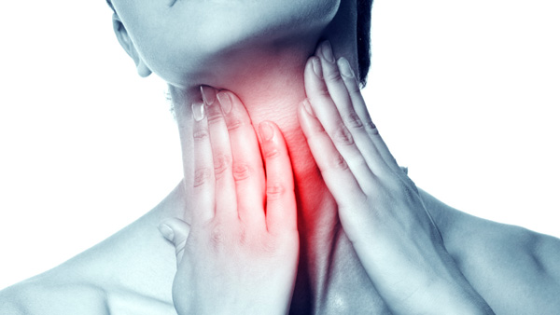
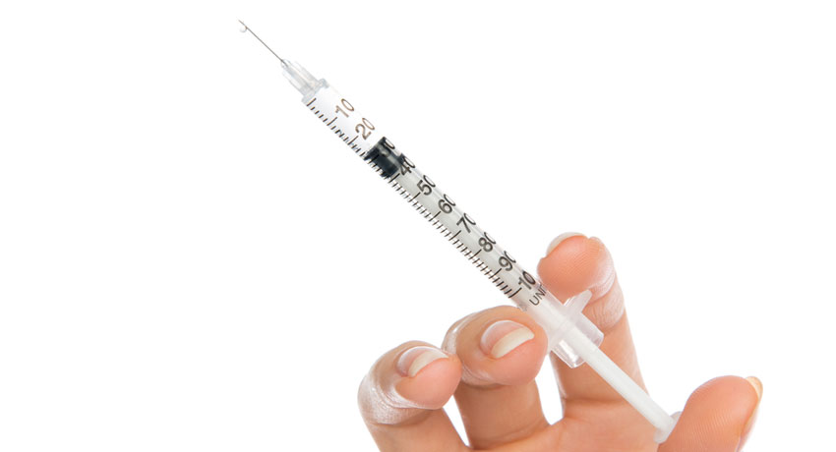
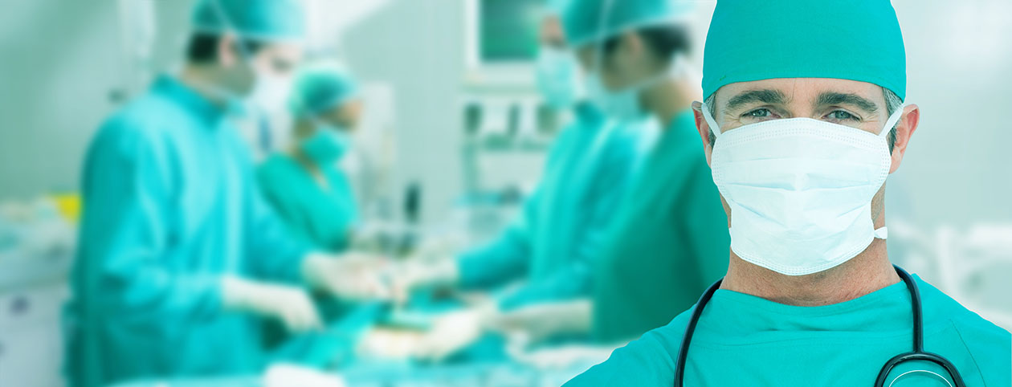
Sore throat is pain or irritation of the throat.
Shot is an act of putting something (such as medicine or vaccine) into the body with a needle.
Surgeon is a doctor who performs operations that involve cutting into someone's body in order to repair or remove damaged or diseased parts.

Slide 21
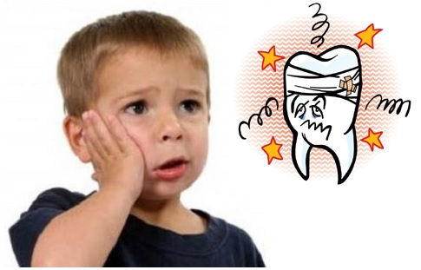
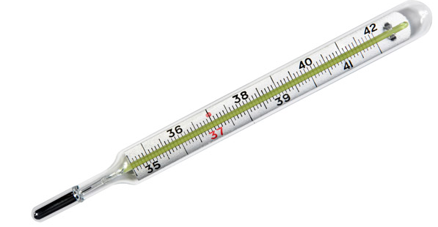
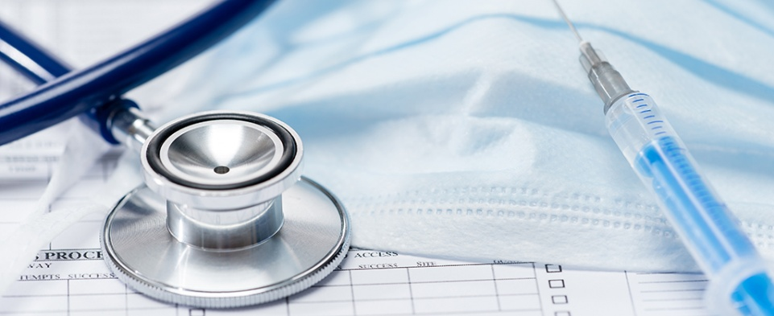
Toothache is pain in or near a tooth.
Thermometer is an instrument used for measuring temperature.
Treatment is something that deals with a disease, injury, etc., in order to make someone feel better or become healthy again : medical care.

Slide 22
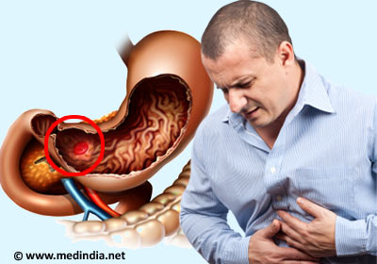
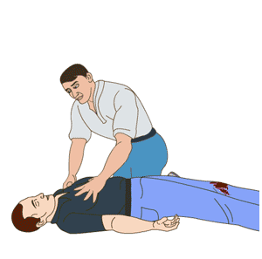
Ulcer is a painful, sore area inside or outside the body.
Unconscious means not awake especially because of an injury, drug, etc.
Unwell - not feeling well

Slide 23
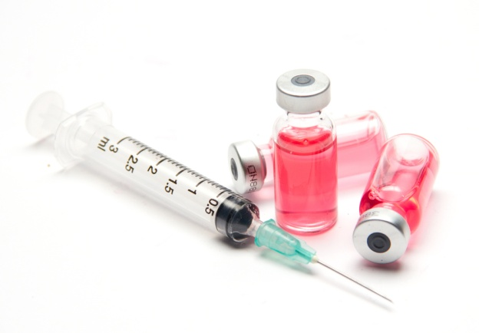
Vitamin is a natural substance that is usually found in foods and that helps your body to be healthy; a pill containing vitamins.
Vaccine is a substance that is usually injected into a person or animal to protect against a particular disease
Virus is an extremely small living thing that causes a disease and that spreads from one person or animal to another.

Slide 24
Waiting room is a room in a hospital, doctor's office, train station, etc., where people can sit down and wait.
Ward is a section in a hospital for patients needing a particular kind of care (a geriatric/maternity/psychiatric ward).
Wheelchair is a chair with wheels that is used by people who cannot walk because they are disabled, sick, or injured.

Slide 25
X-ray means to examine and make images of (things, such as the bones and organs inside the body) by using X-rays.
X-ray photograph - a radiogram made by exposing photographic film to X rays; used in medical diagnosis.

Slide 26
Yoga is a system of exercises for mental and physical health.
Yellow fever is a serious disease that causes fever and often yellowing of the skin and that is passed from one person to another especially by the bite of mosquitoes.

Slide 27
Zoster is a viral disease characterized by a painful skin rash with blisters in a limited area on one side of the body.

Slide 28
References
1) http://www.health.harvard.edu/medical-dictionary-of-health-terms
2) http://www.learnersdictionary.com/

